Slide 1
ICIN BANK
Our single step registration process is quick, easy & secure for your corporate banking needs!

Slide 2
INTRODUCTION
In this application we are going to provide online banking to the customers.
Customers can ﬁnd various types of online banking web services to request for cheque book,check account balance,check transaction details and transfer money between accounts.
The user interface is very user friendly.The data are well protected for personal use and makes the data processing very fast.

Slide 3
FEATURES
USER PORTAL
User Registration
Login
Deposit
Withdraw
Transfer
Transfer Between Primary and Savings account
Cheque book Request
Apply for loan
notiﬁcation

Slide 4
ADMIN PORTAL
Login
Active/disable user account
Accept cheque book request
Accept Loan request

Slide 5
register
ERD
login
login
Loan approve
deposit
Admin
user
withdraw
Checkbook approve
transfer
Disable acnt
loan
chequebook

Slide 6
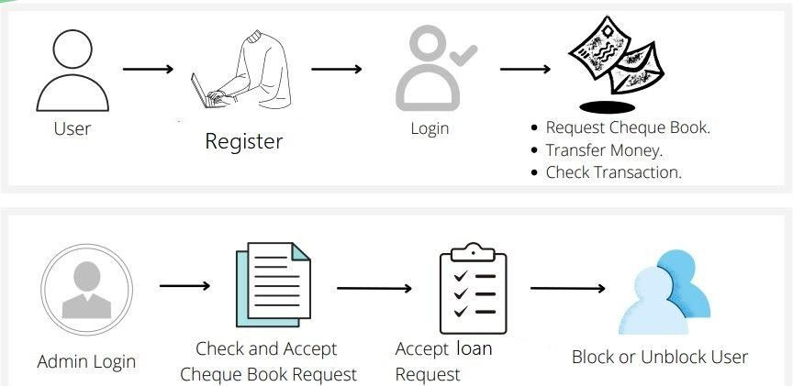
Flow chart

Slide 7
USER PORTAL

Slide 8
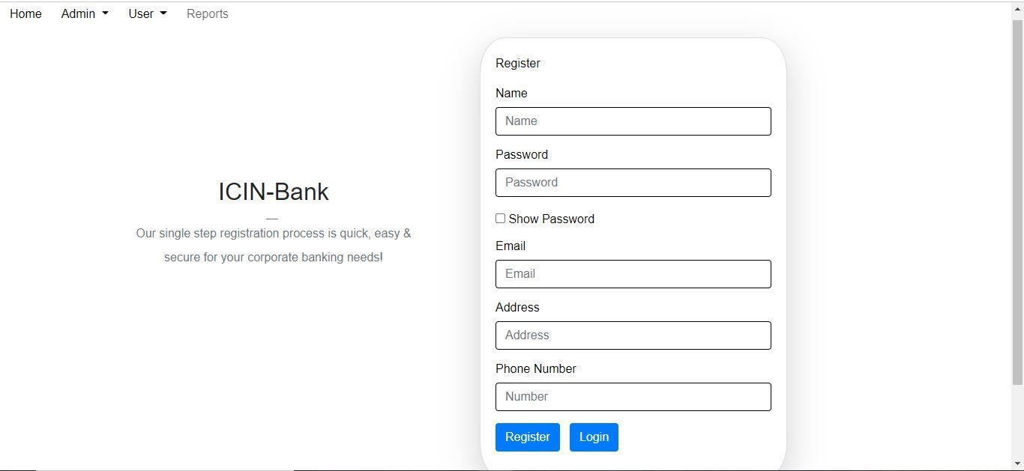
User registration

Slide 9
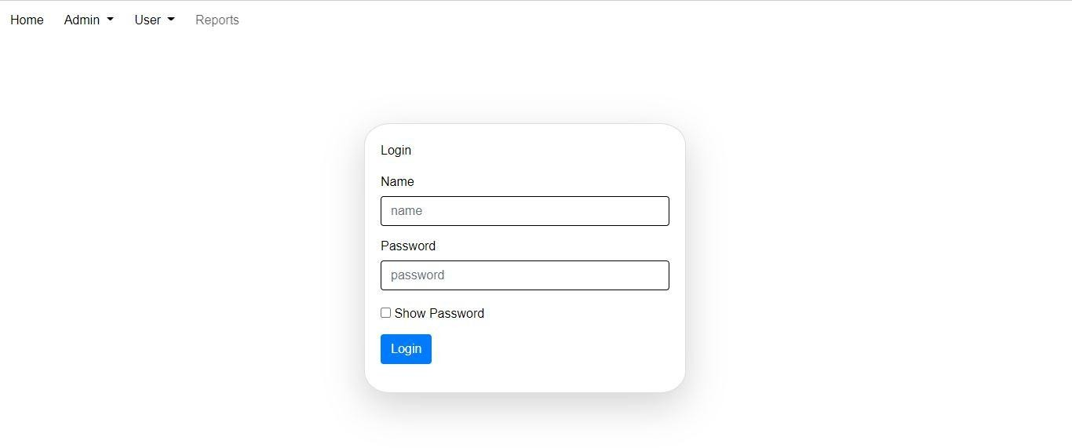
Login

Slide 10
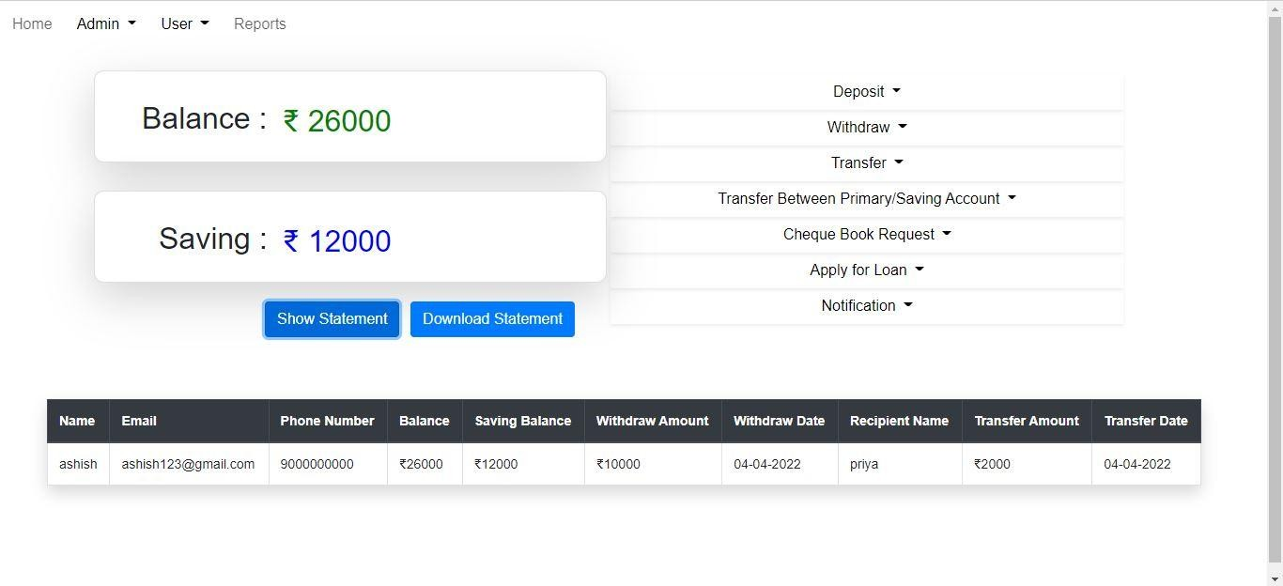
User dashboard

Slide 11
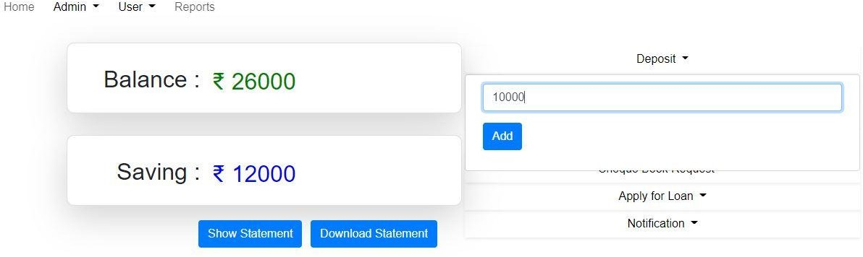
Deposit

Slide 12
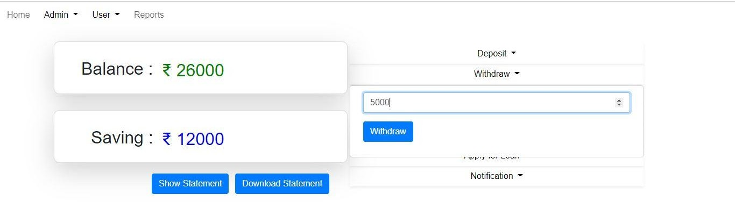
withdraw

Slide 13
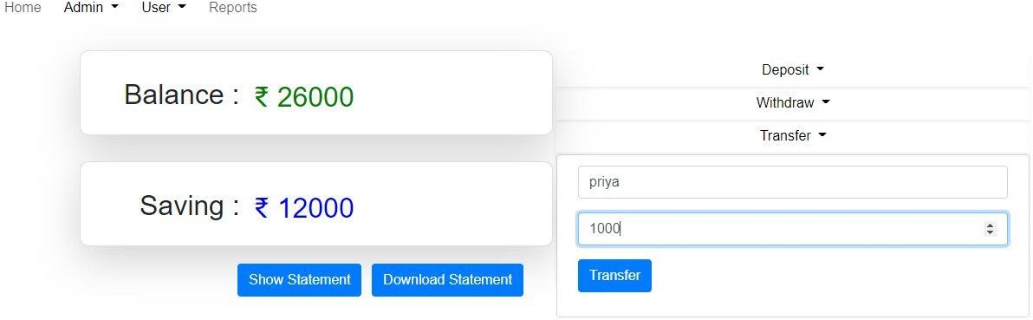
Transfer

Slide 14
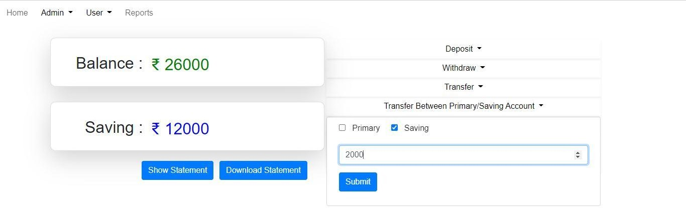
Transfer b/w primary/saving account

Slide 15
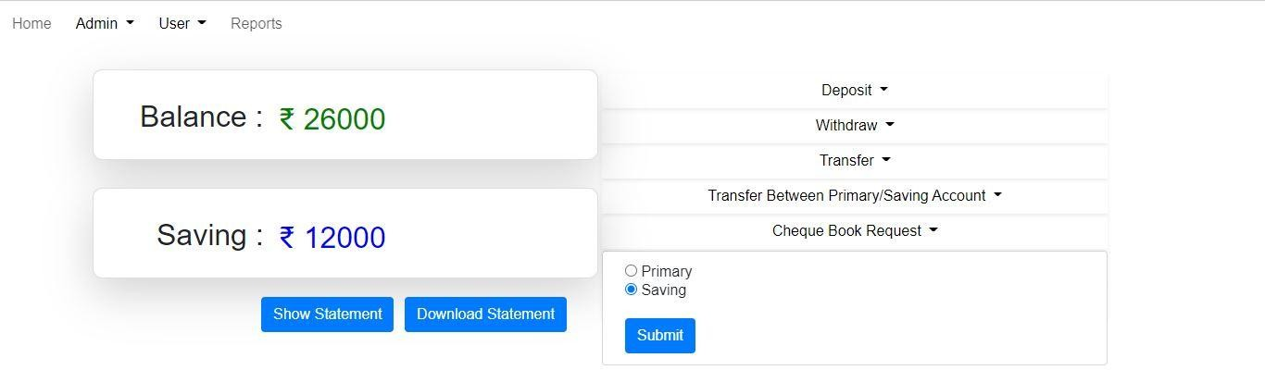
Cheque book request

Slide 16
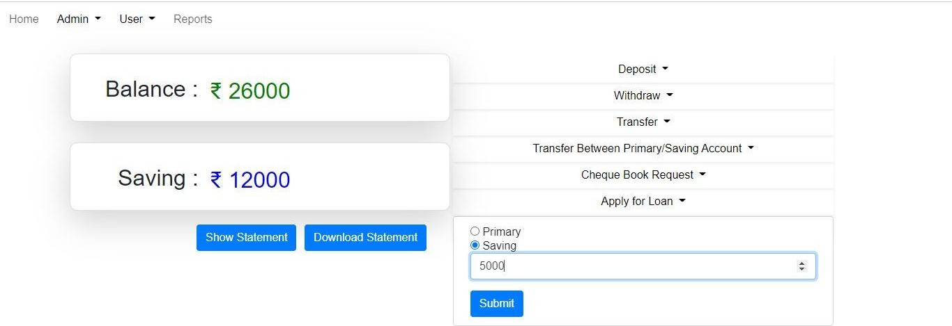
Apply Loan

Slide 17
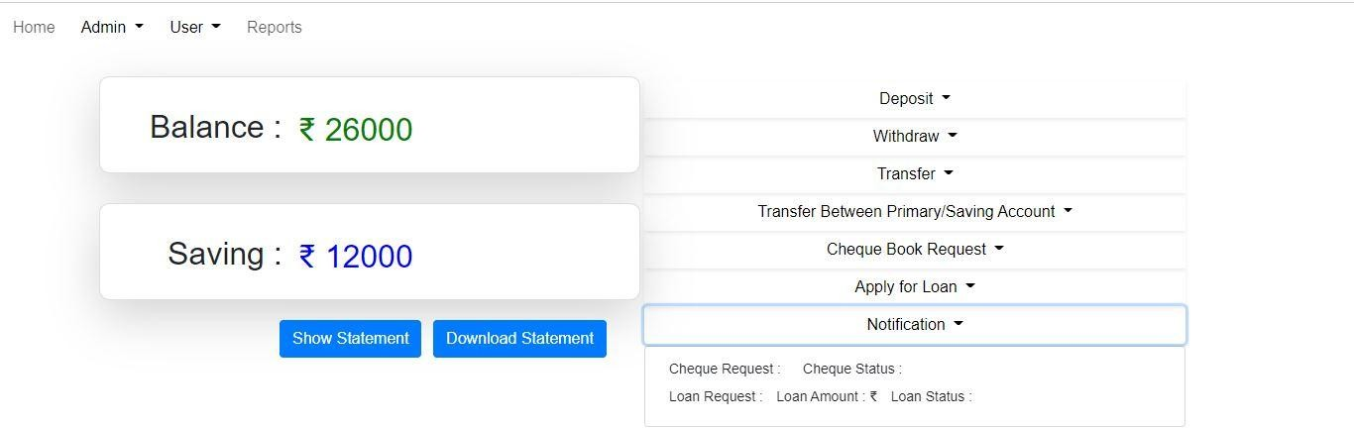
Notiﬁcation

Slide 18
ADMIN PORTAL

Slide 19
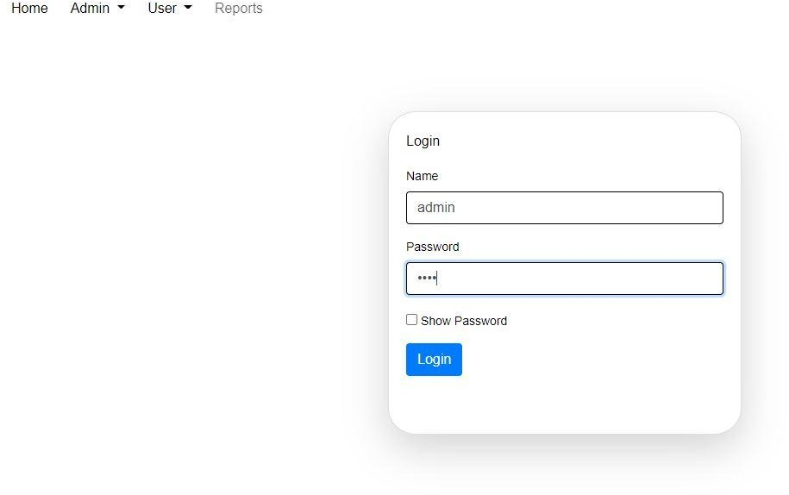
Login

Slide 20
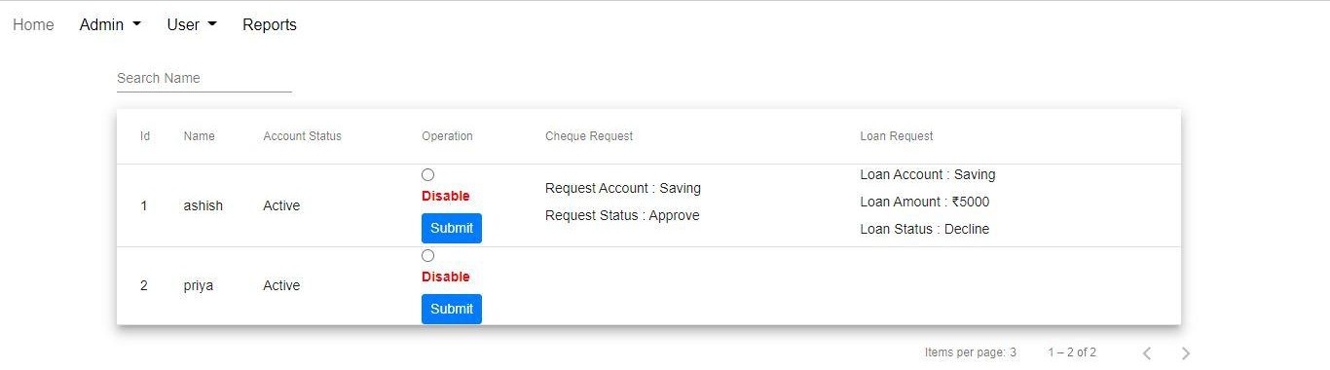
Admin Dashboard

Slide 21
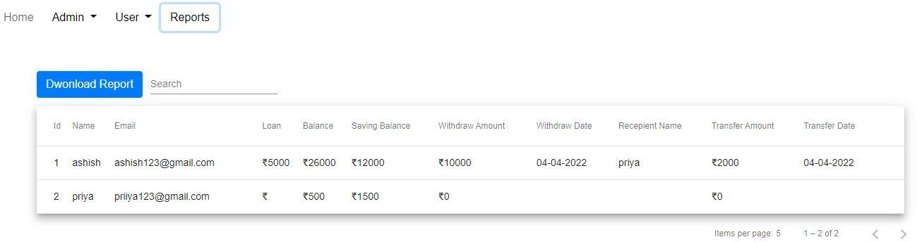
Reports

Slide 22
Future scope
User Portal
user can make there account paper less through the online banking portal.
User can request for credit/debit.
request for loan.
users can block their credit/debit card.
Users can change their basic details.

Slide 23
Admin Portal
Admin can check the eligibility of customer for loan request.
Admin can approve the credit/debit card Request.

Slide 24
Thank You….

